Slide 1
AIRLINE REVIEWS MINI project
Arushi Verma (U2323573K) & Palak Mittal (U2323874C)

Slide 2
CONTENTS
1. Problem statement
2. Data Preparation
3. Exploratory Data Analysis
4. Machine Learning
5. Inference

Slide 3

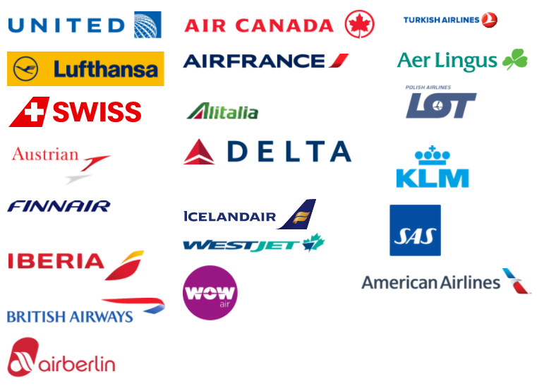
BEFORE WE BEGIN

Slide 4
01
PROBLEM STATEMENT

Slide 5
Developing a tailored evaluation framework to identify the best airline based on reviews and factors including convenience, comfort, and service quality.

Slide 6
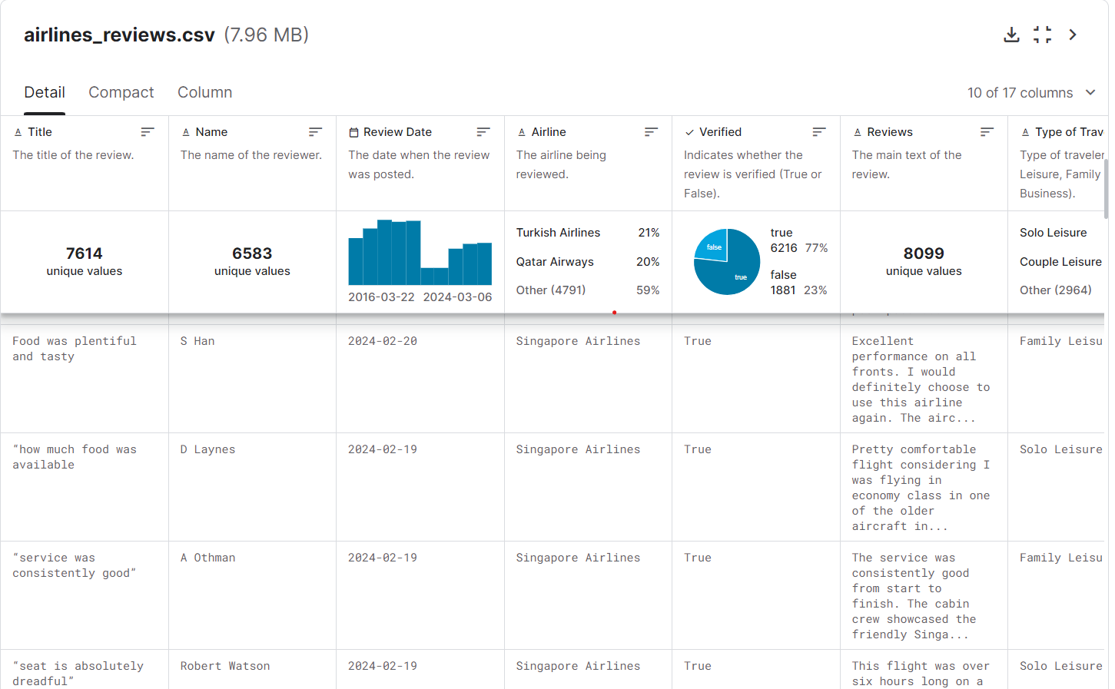

Slide 7
02
DATA PREPARATION
REMOVING REPEATED NAMES
REMOVING UNNECESSARY COL
REMOVING “FALSE” REVIEWS

Slide 8
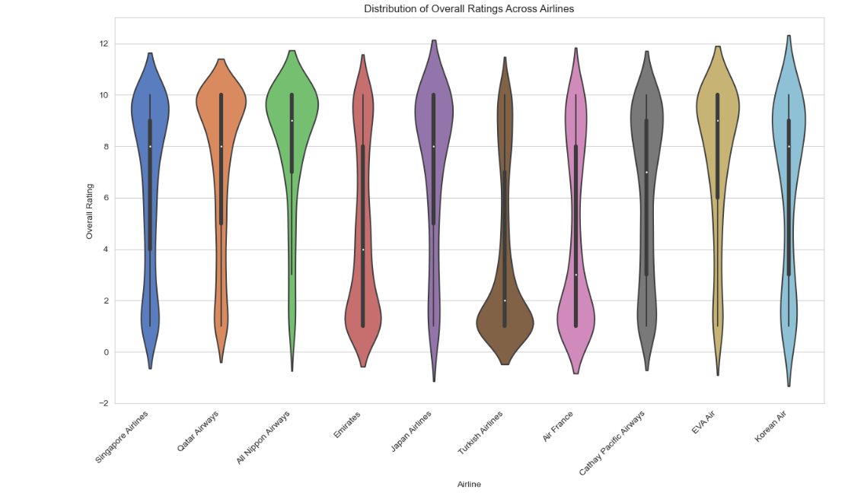
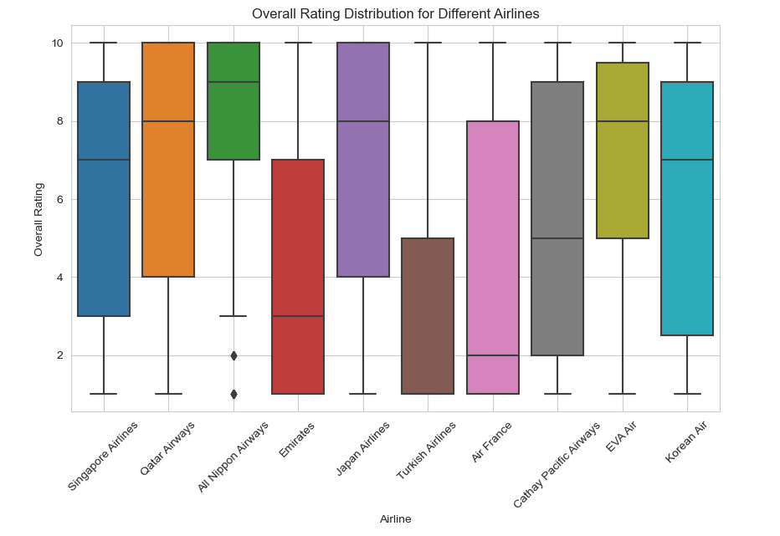
03
Exploratory data analysis
OVERALL RATING FOR EACH AIRLINE
OVERALL RATING DISTRIBUTION FOR DIFFERENT AIRLINES

Slide 9
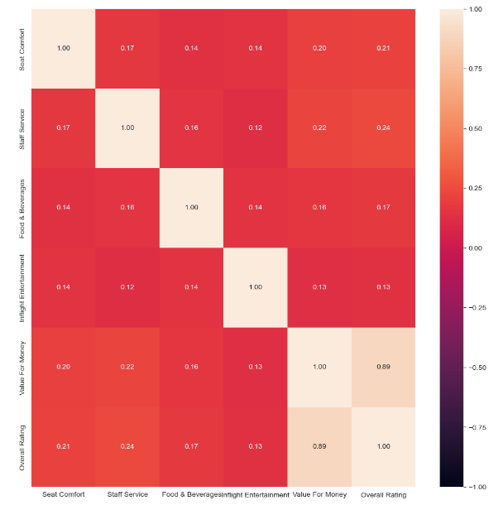
HEAT MAP SHOWING CORRELATION BETWEEN THE VARIABLES AND OVERALL RATING

Slide 10
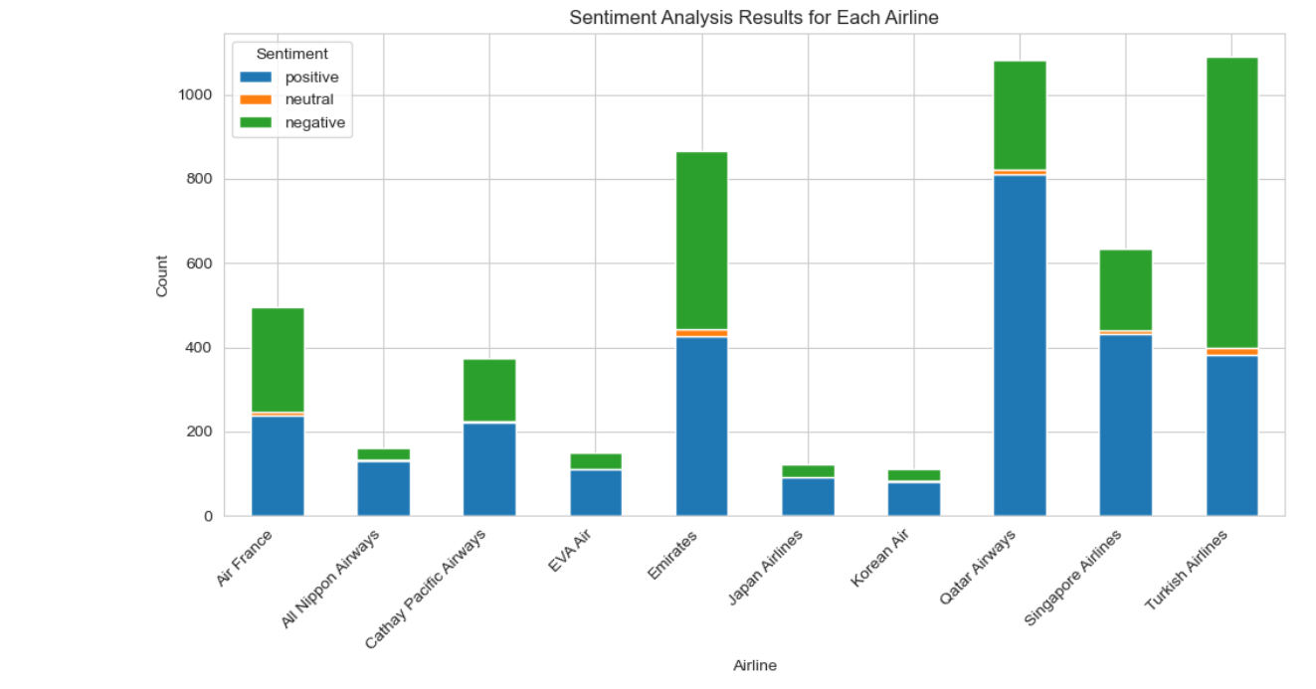
04
Machine learning
Model 1: sentiment intensity analyser
MOST POSITIVE REVIEW -> Qatar Airways
MOST NEGATIVE REVIEW -> Turkish Airlines

Slide 11
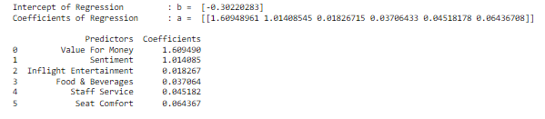
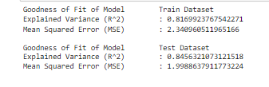
Model 2: LINEAR REGRESSION
COEFFICIENTS OF PREDICTORS
GOODNESS OF FIT OF LINEAR REGRESSION MODEL

Slide 12


Model 3: GRADIENT BOOSTING REGRESSION MODEL
FEATURE IMPORTANCE OBTAINED FROM GRADIENT BOOSTING
GOODNESS OF FIT OF GRADIENT BOOSTING MODEL

Slide 13
Comparing both models
LINEAR
REGRESSION
GRADIENT BOOSTING

Slide 14
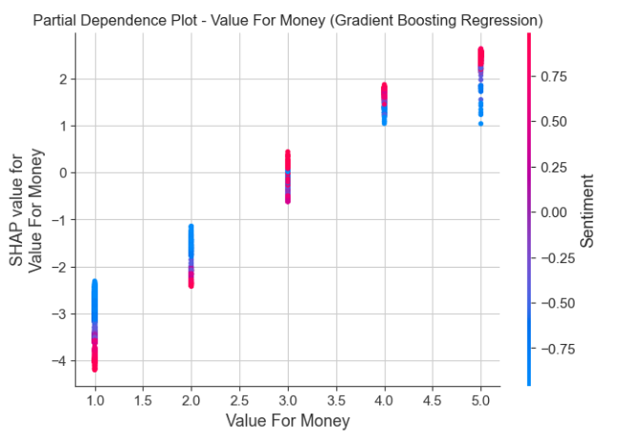
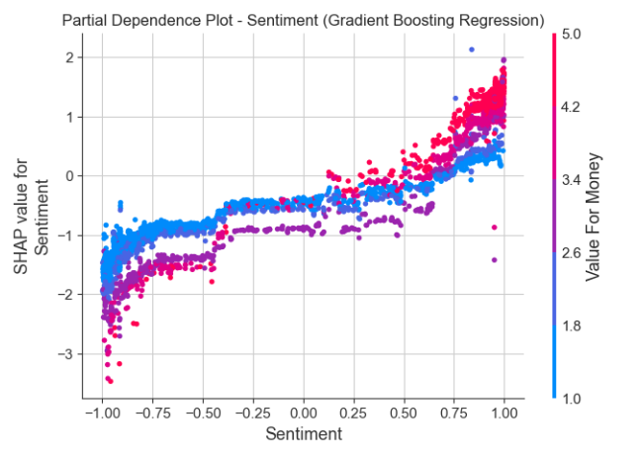
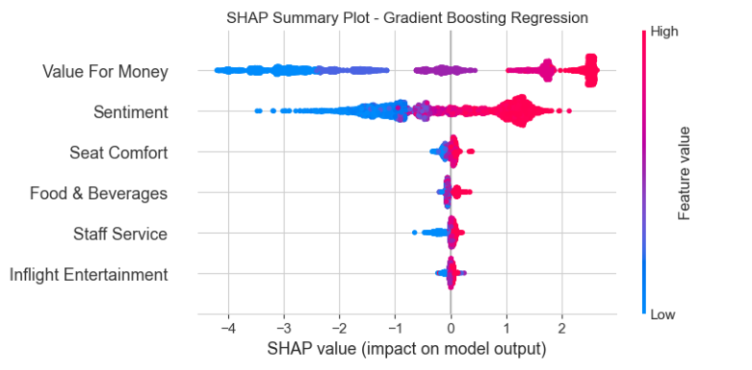
SHAP ANALYSIS

Slide 15
Best airlines
Mean Predicting Rating
7.58
ALL NIPPON AIRLINES
JAPAN AIRLINES
6.80
QATAR AIRWAYS
6.79
6.77
EVA AIR

Slide 16
CONCLUSION
Value for money and Sentiment have the highest feature importance in predicting Overall Ratings i.e. they have the highest impact on the Overall Ratings given by customers.
Other factors: Seat Comfort, Staff Service, Food & Beverages, Inflight Entertainment have little to no impact on the final ratings of customers.
Gradient Boosting Regression model performs better than Linear Regression model when there are more number of predictors.
SHAP analysis can be used to interpret the predictions of machine learning models. It provides explanations for individual predictions by quantifying the contribution of each feature to the model's output.
Thus, we can evaluate the performance of airlines based on customer reviews using the framework we found through Gradient Boosting Regression.

